Slide 1
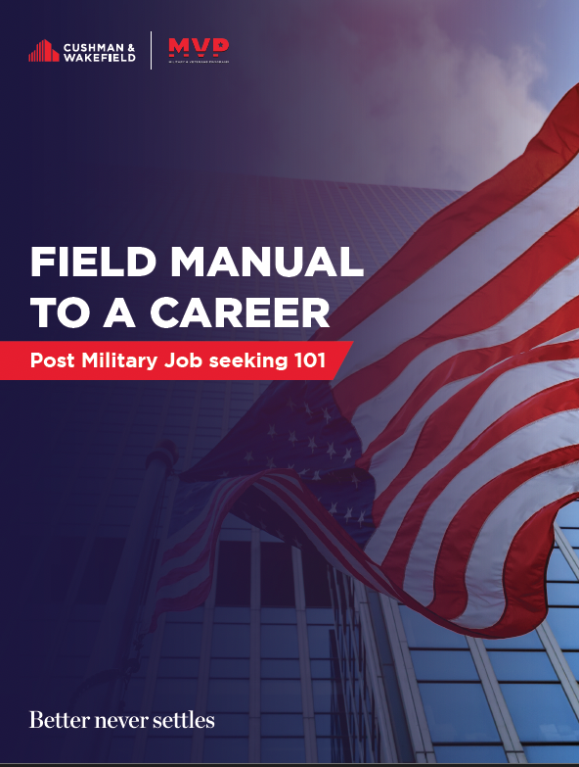

FIELD MANUAL TO A CAREER
Post Military Job seeking 101

Slide 2


Field Manual to a Career
Post Military Job seeking 101
FROM THE TEAM
We know that searching for a post-military career isn’t easy.
Whether you’re recently separating from the armed forces, or you’ve been out for a while – job searching can be an intimidating and sometimes frustrating process. But it doesn’t have to feel impossible. Let us help guide you.
This is a quick reference guide for pursuing post-military opportunities and networking. It’s not all the answers, but it’s a great starting point.
As a service member, you’ve been exposed to a lot of people, places, expectations, experiences and skills. A common theme from post-military job application is over-generalization of skills and experiences.
In other words, your military and other experience has exposed you to a lot of different things and you may have a tendency to say, “I could do this job”. Of course, you probably can and, as is common in the military, you’ve had to learn on the fly how to do jobs – but in the civilian sector, each job to which you apply may be asking for specific, targeted experience.
There may be little room for learning on the fly, as companies often want someone to hit the
ground running.

Slide 3
Field Manual to a Career
Post Military Job seeking 101
In many cases you will need to be able to display or show substantial experience or knowledge related to the job for which you're applying.
As you’re out there looking at roles, applying and making connections, remember a few important factors that will help you understand how to best work the process of finding your next great job.
Depending on the size of a company, the average recruiter is handling 15-25 requisitions (job openings) at a time inside of the company. In some companies, a recruiter may have over 50.
Each requisition may have over 100 applicants, some with great, matching experience to the needs of the requisition.
Recruiters are bound by requirements, certifications, experience, location and other factors. Sometimes, a recruiter may be filling a requisition for a client – which means the client has very specific requirements for the role.
Recruiters aren’t often equipped to act as a job-search resource for the job seeker. In other words, they’re employed to find the best talent for the company or job and may not have time to help you find your next role. There are veteran-based services that can help with this.
Recruiters and Military Program teams can act as a liaison or connection point to help with introductions and/or job details.
Qualifications, Under and Over….
Qualifications are a series of defining factors regarding who gets selected to move into the job.
The most qualified candidates are considered for the role. These qualifications are often written
out in the job description.
Qualifications are generally calculated as experience in specific specialties, education, certifications and sometimes even cultural fit. “Most qualified” isn’t an exact science. Qualifications aren’t simply JUST the experience for the job. As you may have learned in the military, adaptability is also a key element in operational success. Sometimes being ABLE to do the job, or learn it, is very valuable too.
You may be under or overqualified for a job. In either case, you may not be a good fit for the role. Underqualified candidates may not have the appropriate level of experience to do the job effectively while overqualified candidates will be under-utilized and often leave the job early for something that comes along better fitting with their experience.
Remember, recruiters don’t make the hiring decisions. They’re a conduit to the manager. There are generally a team of people making a decision on who gets the job.

Slide 4


Field Manual to a Career
Post Military Job seeking 101
HERE ARE SOME TIPS FOR APPLYING AND CONNECTING:
Networking is #1
- While it may sound contradictory to what was mentioned about recruiters being very busy, they do attend virtual and physical events along with managers and executives. For some people, networking and knocking on doors may not be a comfortable situation – but it’s vital and among the most useful skills in career growth.
LinkedIn – likely the most valuable tool for sharing your “resume” and experiences with the world. But you must be active here.
50Strong – 50Strong is an organization that regularly hosts virtual conversational breakout rooms between recruiters/ managers/execs and active/former service members. Over the years
it’s resulted in tens of thousands of great
connections.
Networking continued
- Your skillsets and abilities are absolutely relevant to finding the right job, sometimes getting the right connections and conversations inside of a company can help you to better understand the job and how it may fit with your background, even if you don’t have ALL of what they’re asking for.
Just applying to jobs and waiting for responses is the “steam engine” of job seeking anymore. It still works, but it’s now obsolete as a practice alone.
Pro Tip: Don’t drop into an inbox asking for a job. Ask for a
conversation about how that person got where they’re going and what challenges they faced. People love to tell their story, but they’re not always equipped to plug you into a job. A conversation can lead to an intro.
CUSHMAN & WAKEFIELD

Slide 5



Field Manual to a Career
Post Military Job seeking 101
Tailor your resume
Tailor your resume to the job for which you’re applying – You’ve heard this one before and while it sounds painstaking (for example) you likely won’t have success applying to a Structural Engineering
job with a resume that has no structural engineering on it. It’s as simple as that.
Don’t fudge the resume and experience, but if it’s relevant to the job and you have some/most/all of the experience, you should highlight those relevant strengths and experiences in the resume.
Look at the bullets of the job description. If it asks for a few years, certifications, experience…etc, and you have those things, list them using the same words the job description asks for.
You don’t always have to have EVERYTHING the description is asking for. Sometimes you can have 80% of
it and learn the rest. Be prepared to talk about how you’d close the gap on learning if you were offered the job.
Know what you’re good at, or what you want to be good at
Have your elevator pitch ready. Doesn’t have to be perfect – just an understanding of what you can offer to a team. Can you turn that into a career? Is it meaningful to what you’re applying?
Remember, your career is a lattice not a ladder. It can go up, down and side to side.
CUSHMAN & WAKEFIELD

Slide 6
Field Manual to a Career
Post Military Job seeking 101
DO’S AND DON’TS
DO:
DON’T:
Story tell on LinkedIn.
Professional interests or events that you attend, certifications, degrees, and career relevant stories help you build your personal brand.
Assume that a company isn’t hiring veterans because they didn’t hire you.
Ask your connections to introduce you to others who may help you make progress. Every conversation you have should include “is there anyone else you can recommend or introduce me to?”.
Apply to and pursue jobs for which you don’t have all the qualifications. There may be room for growth.
Take to LinkedIn expressing your displeasure with your job search. It will tarnish your personal brand and be of little help. Remember, everyone can see your LinkedIn activity.
Send emails of frustration to managers or recruiters if you don’t land the job. Instead, ask them if you can stay in touch for other opportunities.
Make a few resume drafts for different types of specialties, so that you can quickly and easily edit and send them as needed. Tailor the resume to what the job is asking for.
Send a resume to a recruiter or company team member and ask “do you have anything?” Look for roles and get specific.
Take good advice and act on it. Not all advice is the right advice, and there’s a lot of it out there. Look
for common themes in the advice you’re getting.
Give up. Giving up and getting frustrated will only harm your chances and motivation. Careers are like a lattice, not a ladder.
You can go up, down, side to side – sometimes setbacks can lead to great things.
Interview with as many people as you can. Even for jobs you don’t want. Sounds counterproductive? Interview practice makes you better each time. The interview for the job you don’t want may result in a conversation about a job you do want.

Slide 7



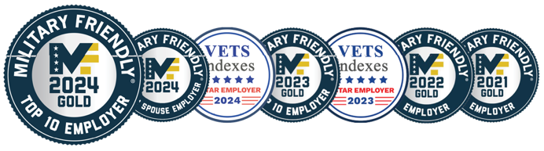
Matt Disher
Executive Director
Military & Veterans Programs Veteran, US Marines
Jamie McCall
Sr. Military Programs Partner Skillbridge Lead
Veteran, US Army National Guard
Billy Flagg
Military Programs Specialist Veteran, US Army

